Slide 1

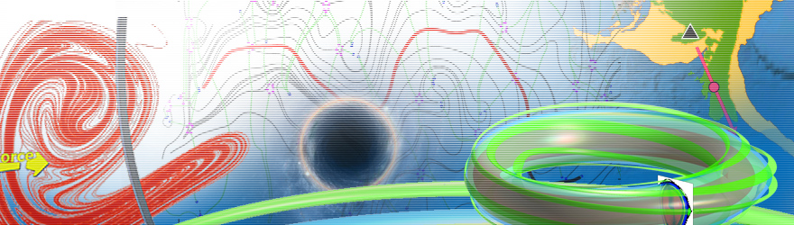
Biological Dynamics Modeling
韦添元（助教）15811823840
11849117@mail.sustc.edu.cn
王冠宇 18665955633
wanggy@sustc.edu.cn

Slide 2
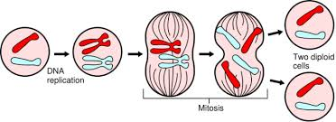
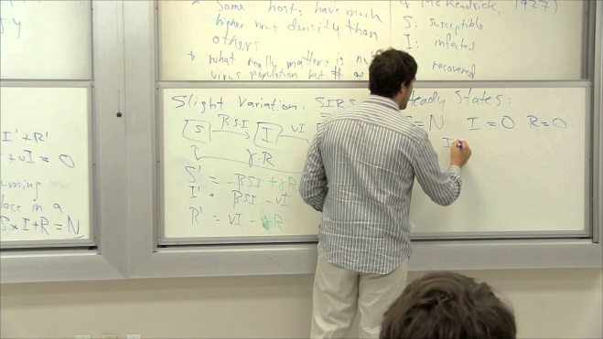

Biology + Dynamics

Slide 3
分子动力学模拟
生物大分子结构，所有原子的运动轨迹，经典的牛顿力学
分子对接，力场，Amber software package
动力系统基本概念
状态空间、连续及离散系统、稳定性、系统终态的分类
线性系统理论
线性系统的解析解，脉冲响应函数
拉普拉斯变换
控制理论初步
生物网络
对基因调控、信号传导、蛋白相互作用的网络建模
实例分析
机体层次上的动力学模拟

Slide 4
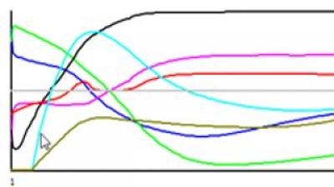
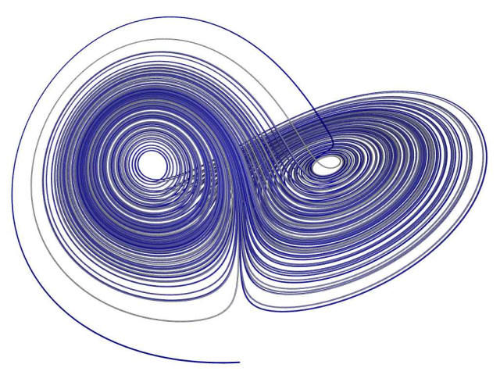

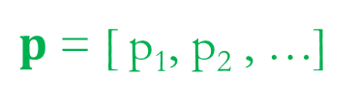

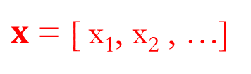
Dynamical systems theory
An area of mathematics used to describe the behavior of complex dynamical systems, usually by employing differential equations or difference equations.
x₁
Continuous
x₂
$$\frac{dx}{dt}=f(x,p,t)$$
t
$x$ = [ x₁, x₂ , …]
x₂
$p$ = [ p₁, p₂ , …]
Discrete
$$x\left(t+1\right)=f(x\left(t\right),t)$$
x₁

Slide 5
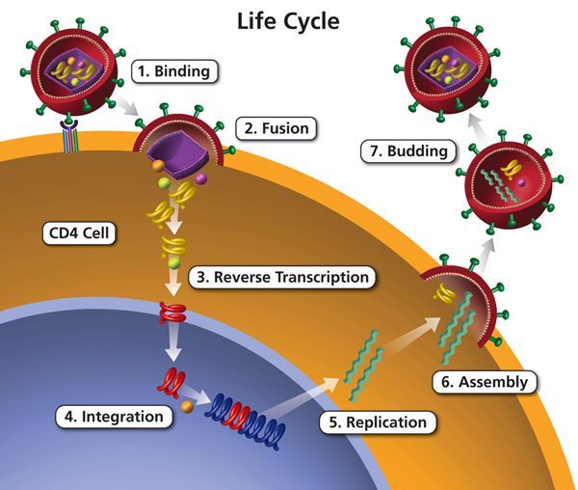
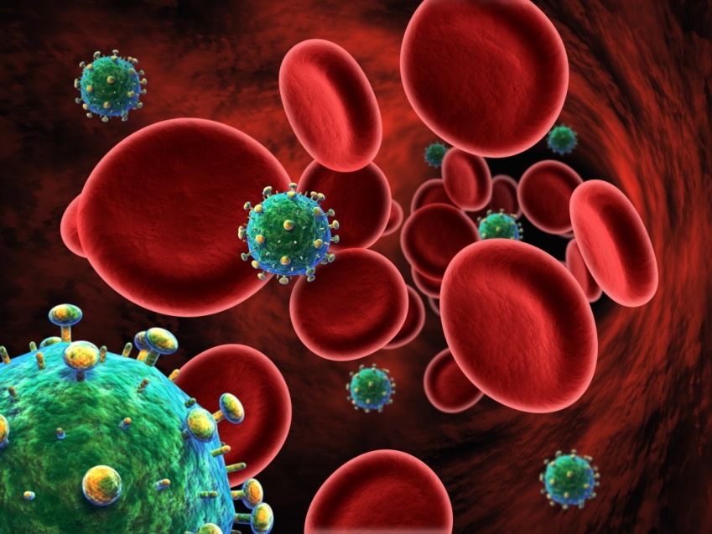
Biological dynamical systems
Population level: HIV dynamics

Slide 6
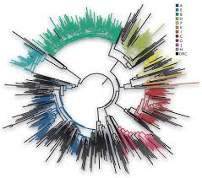
Viral-host interaction: complexity and diversity in the immune system
Virus and the immune system have immense diversity.
Virus induces immune system competition by
rapid mutation.
New Vaccination strategies based on immune system modelling.
Wang & Deem PRL 97, 188106 (2006)

Slide 7
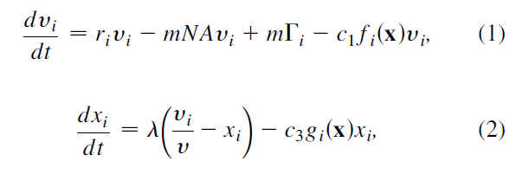
Wang & Deem PRL 97, 188106 (2006)

Slide 8
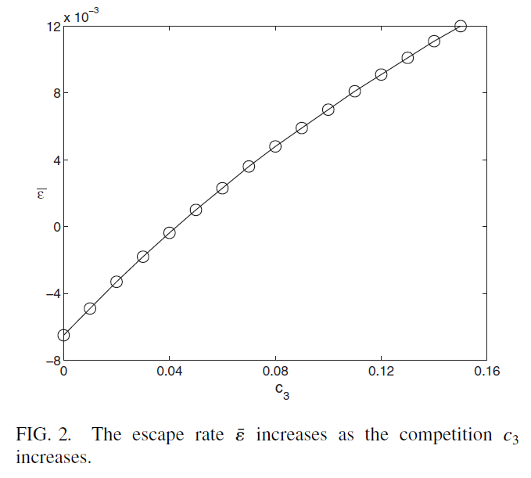

Slide 9
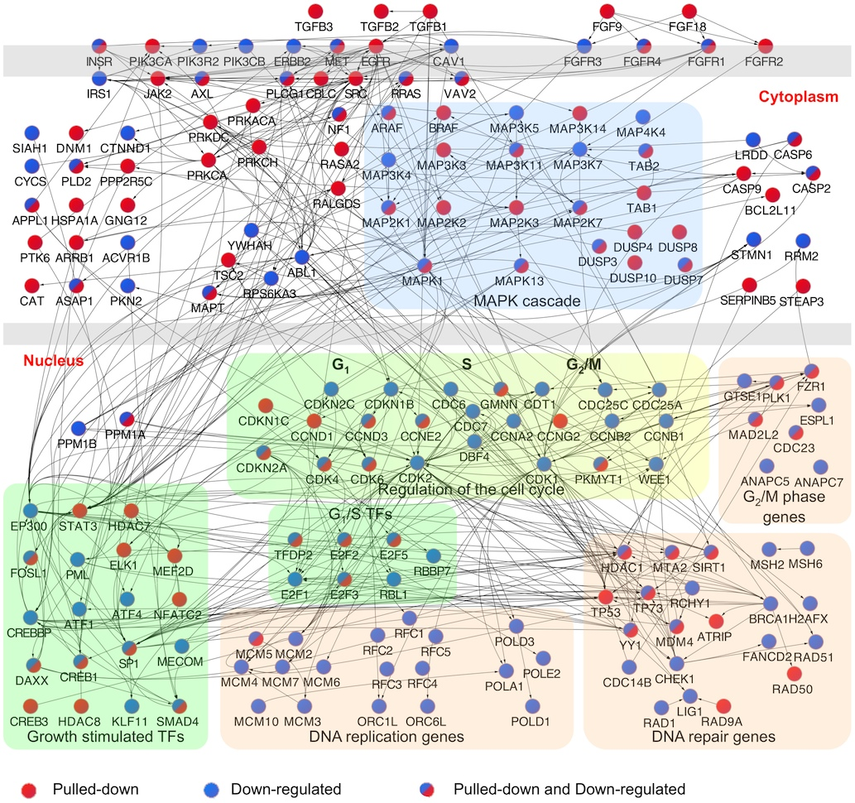
Biological dynamical systems
Molecular systems level: network dynamics

Slide 10
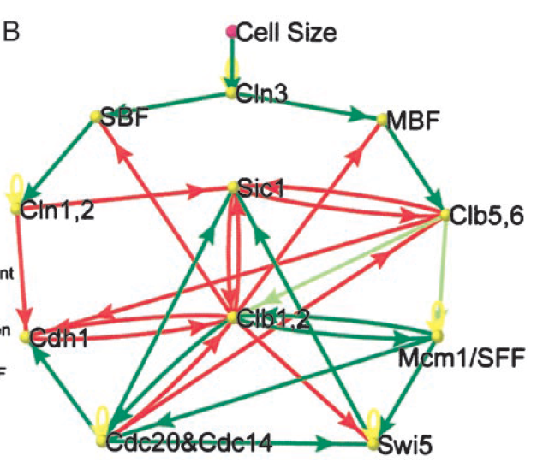
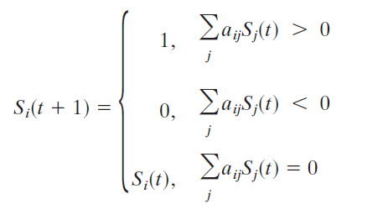
Budding yeast cell cycle network
11 nodes
34 edges
Binary states
Li et al.

Slide 11
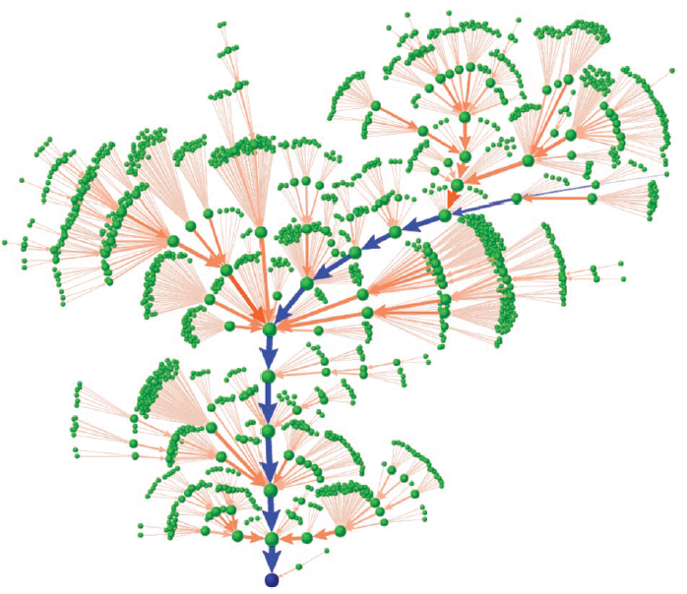
State transitions
2¹¹=2048 states
Yeast cell cycle network is robustly designed !

Slide 12
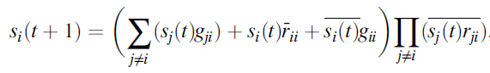
Boolean Algebra based modeling
Wang et al.

Slide 13
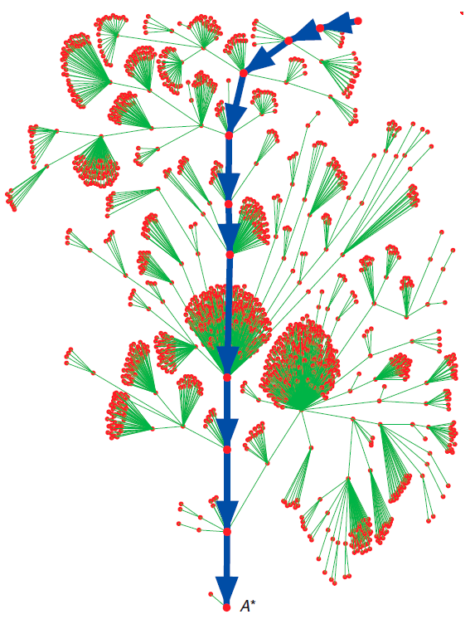

Slide 14
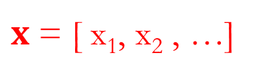
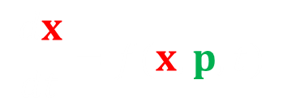

Reverse engineering: from trajectory to determine parameter values.
x₁
$$\frac{dx}{dt}=f(x,p,t)$$
x₂
$x$ = [ x₁, x₂ , …]
t
$p$ = [ p₁, p₂ , …]
x₂
x₁

Slide 15
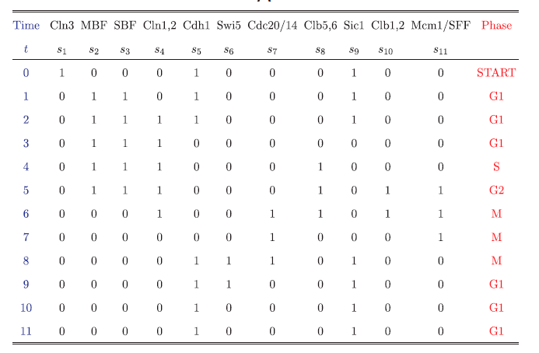
Reverse engineering
Given a state transition trajectory, what networks can realize it?

Slide 16
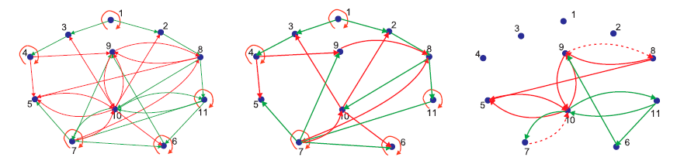
10³⁰ networks can
Among them, only about 40000 minimal networks (23 edges)

Slide 17
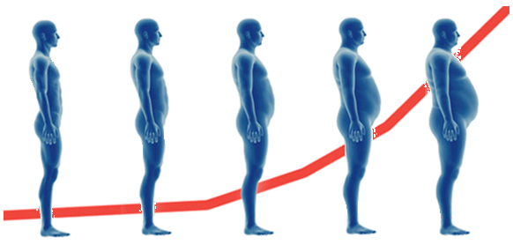
Biological dynamical systems
Organismal level: body weight change dynamics

Slide 18
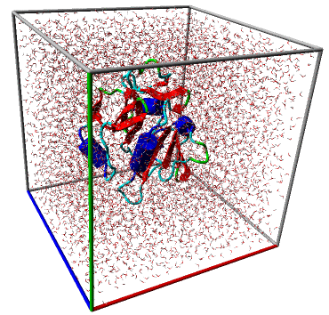
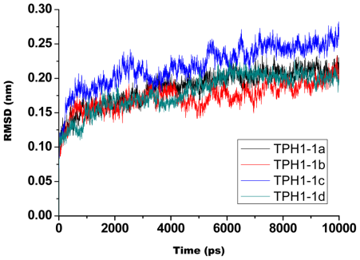
Biological dynamical systems
Atomic level

Slide 19
Enzyme PGAM1

Slide 20
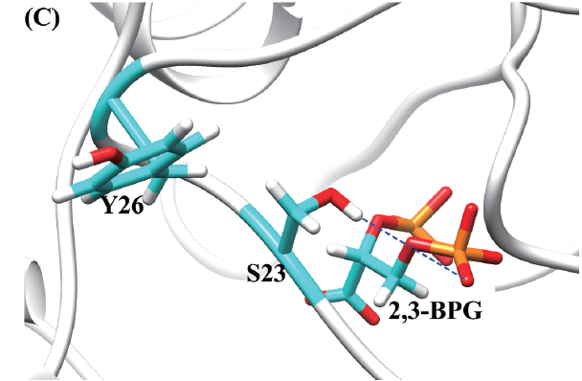
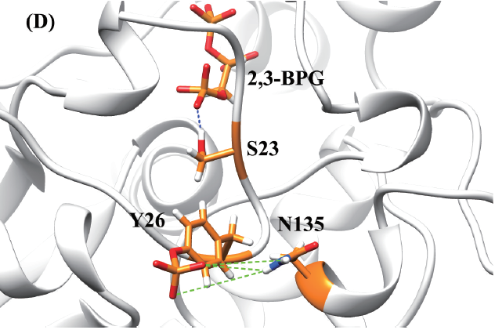
Molecular Dynamics Simulation
Wild-type system
Y26 phosphorylated

Slide 21
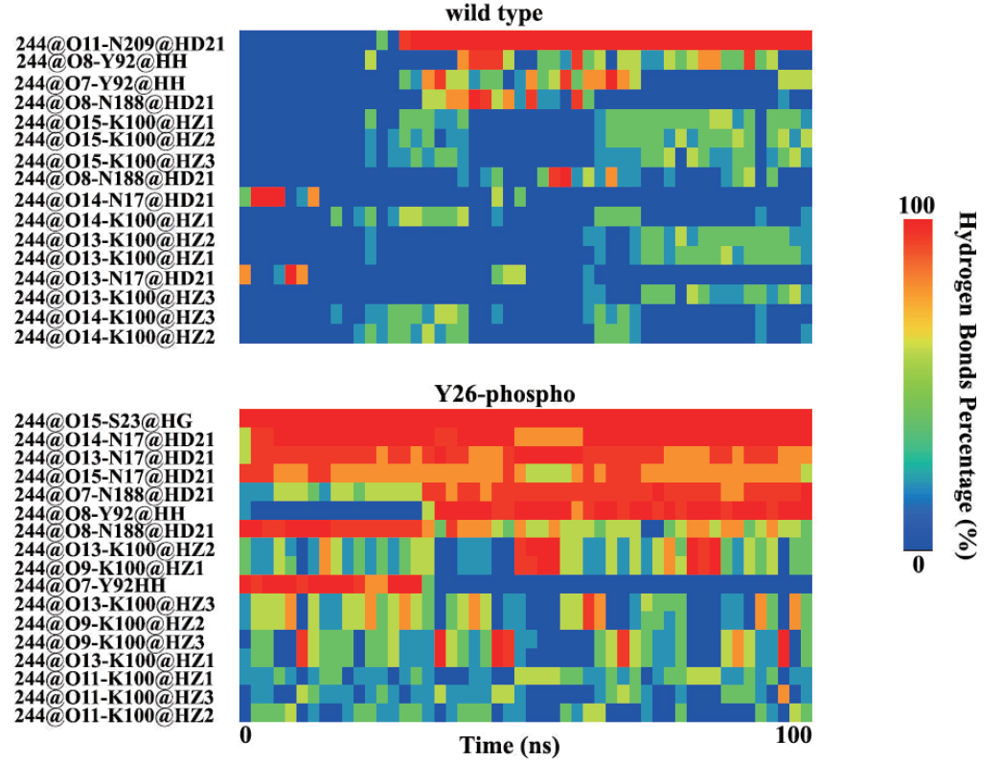

Slide 22
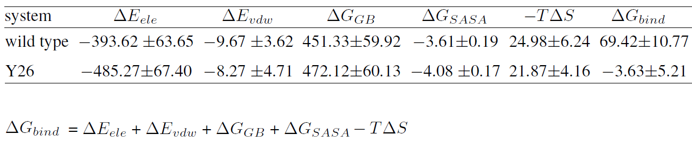
Binding free energy calculation

Slide 23
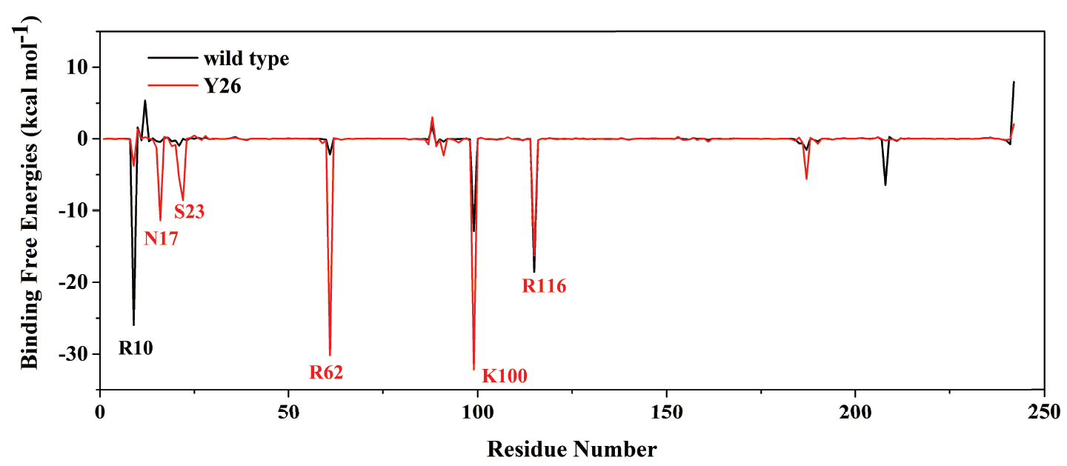
Per-residue binding free energy

Slide 24
Summary
Tyr26 phosphorylation of PGAM1 provides a metabolic advantage to tumors by stabilizing the active conformation

